Slide 1
Science Subject
for Pre-K:
Science Tools
Science Tools
Here is where your presentation begins

Slide 2
Contents of this template
Here’s what you’ll find in this Slidesgo template:
A slide structure based on an education presentation for pre-k, which you can easily adapt to your needs. For more info on how to edit the template, please visit Slidesgo School or read our FAQs.
An assortment of pictures/illustrations that are suitable for use in the presentation can be found in the alternative resources slide.
A thanks slide, which you must keep so that proper credits for our design are given.
A resources slide, where you’ll find links to all the elements used in the template.
Instructions for use.
Final slides with:
The fonts and colors used in the template.
A selection of illustrations. You can also customize and animate them as you wish with the online editor. Visit Storyset to find more.
More infographic resources, whose size and color can be edited.
Sets of customizable icons of the following themes: general, business, avatar, creative process, education, help & support, medical, nature, performing arts, SEO & marketing, and teamwork.
You can delete this slide when you’re done editing the presentation.

Slide 3
Template with wordarts
This is WordArt text.
If you want to modify it:
Double click on it
Type your new text in the dialog box
You can change the fill color in the top menu
You can also modify the stroke, its color, thickness or type
Press Enter
Wordarts

Slide 4
Table of contents
Introduction
Science tools
01
02
You can describe the topic of the section here
You can describe the topic of the section here
Activities
About us
03
04
You can describe the topic of the section here
You can describe the topic of the section here

Slide 5
Hi science!
This can be the part of the presentation where you introduce yourself, write your email…

Slide 6
01
Introduction
Introduction
You can enter a subtitle here if you need it

Slide 7
Introduction
Introduction
Venus has a beautiful name and is the second planet from the Sun. It’s terribly hot and its atmosphere is extremely poisonous. It’s the second-brightest natural object in the night sky after the Moon

Slide 8
Science needs tools!
Do you know what helps you make your point clear? Lists like this one:
They’re simple
You can organize your ideas clearly
You’ll never forget to buy milk!
And the most important thing: the audience won’t miss the point of your presentation

Slide 9
“The good thing about science is that it's true whether or not you believe in it”
–Someone Famous

Slide 10
Tools to compare and record
Compare
Record
Saturn is the ringed planet. It’s a gas giant, composed mostly of hydrogen
The reason why Neptune is blue is the presence of methane gas

Slide 11
Organize data with
A
B
C
Numbers
Letters
Pictures
Jupiter is a gas giant and the biggest planet of them all
Earth is still the only world known to support life
Mercury is the smallest planet of them all

Slide 12
A picture reinforces the concept
the concept
Images reveal large amounts of data, so remember: use an image instead of long texts

Slide 13
Some interesting details
Safety equipment
Measurement tools
Neptune is blue due to the presence of methane gas
Venus has a beautiful name, but it’s terribly hot
Optical instruments
General tools
Jupiter is the biggest planet in our Solar System
Despite being red, Mars is a very cold place

Slide 14
Awesome words
words
Because keywords catch your audience’s attention

Slide 15
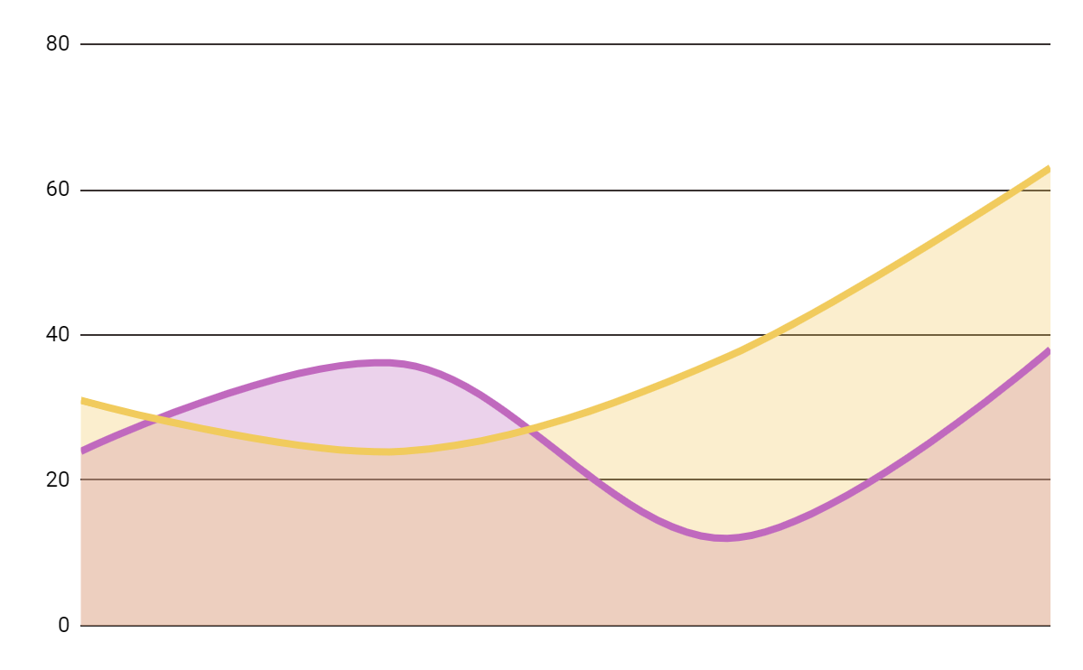
Collecting data
Record
Neptune is blue due to the presence of methane gas
Presenting
Jupiter is the biggest planet in our Solar System
Test 1
Test 2
Test 3
Test 4
Follow the link in the graph to modify its data and paste the new one here. For more info, click here

Slide 16
Reviewing concepts
Eye dropper
Test tubes
Microscope
Despite being red, Mars is a very cold place
Neptune is the farthest planet from the Sun
Mercury is the closest planet to the Sun
Scale
Lab coat
Bunsen burner
Jupiter is the biggest planet of them all
Saturn is the ringed planet and a gas giant
Mercury is the closest planet to the Sun

Slide 17
Some percentages
50%
30%
20%
Mercury is the closest planet to the Sun
Venus is an extremely
hot planet
Saturn is the only planet
with rings

Slide 18
Some tools in the laboratory
Mixing bottle
Bunsen burner
Mercury is the smallest planet
Measuring cup
Neptune is very far from the Sun
Saturn is the only planet with rings
Microscope
Test tube
Venus has a very toxic atmosphere
Despite being red, Mars is a cold place

Slide 19
Other tools
Tool | Type | Description
Thermometer | Measurement | Saturn has several rings
Balance | Measurement | Venus has a beautiful name
Magnet | General | Mercury is the smallest planet
Clock | Measurement | Despite being red, Mars is cold
Chart | General | Earth is the only planet with life
Notebook | General | The moon is a satellite

Slide 20
Experiment timeline
Ideation
Theory
Approach
Venus has a very beautiful name
Mercury is the closest planet to the Sun
Saturn is the only planet with rings
Phase 1
Phase 2
Phase 3

Slide 21
Experiment timeline
Testing
Recording data
Analysis
Neptune is very far from the Sun
Despite being red, Mars is a cold place
Jupiter is the biggest planet of them all
Phase 4
Phase 5
Phase 6

Slide 22
24h 37m 23s
333,000
386,000 km
is Jupiter's rotation period
Earths is the Sun’s mass
is the distance between Earth and the Moon

Slide 23
Mindmap
Earth
Mars
Jupiter
Earth is the only planet with life
Mercury is the smallest planet
Jupiter is the biggest planet
Saturn
Venus has a toxic atmosphere
The Sun is the star at the center
Saturn is the only planet with rings

Slide 24
Match the objects!
Test tube
Magnet
Sample plate
Microscope
Bunsen burner
Rule
Hand lens

Slide 25
Great science museums for kids
Fly kids
Jupiter is a gas giant
Science garden
Earth is where we live
Hall of science
Mars is a cold place

Slide 26
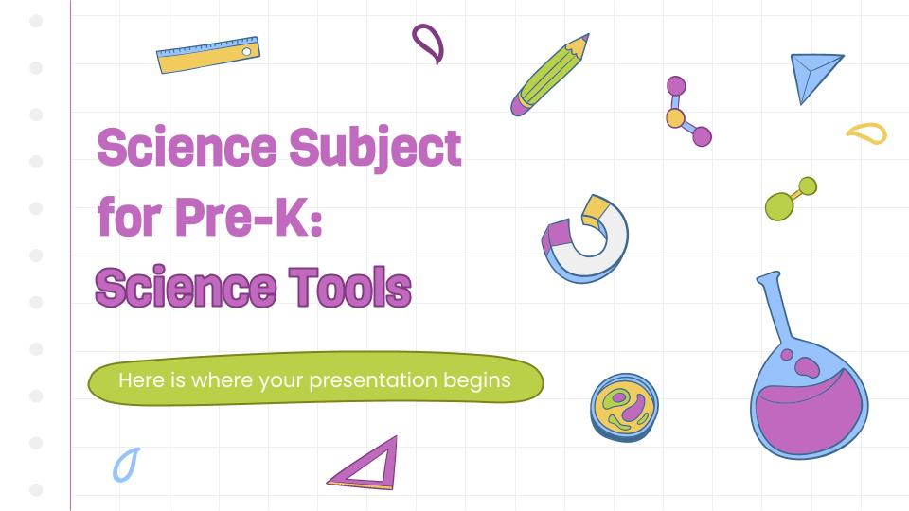
Visit our web
You can replace the image on the screen with your own work. Right click on it and choose "Replace image" so you can add yours

Slide 27
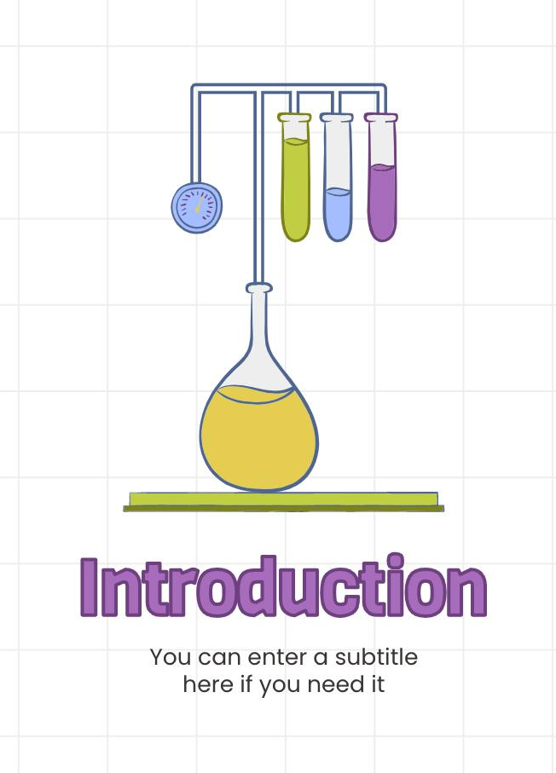
Follow us!
You can replace the image on the screen with your own work. Right click on it and choose "Replace image" so you can add yours

Slide 28
Thanks!
Thanks!
Do you have any questions?
addyouremail@freepik.com
+91 620 421 838
yourcompany.com
Please, keep this slide for attribution

